Slide 1



Ensuring Regulatory Independence in Japan
The EGC experience: law, expertise, culture and budget
Text Day/Month/2026

Slide 2


Regulator within government
— but independent in decision-making
Decision Making
Other organizations
Economic and Industrial Policy Bureau
Manufacturing Industries Bureau
Trade and Economic Security Bureau
Agency for Natural Resource and Energy
Japan Patent office
etc..
Minister
Policy Recommendation
Rule-makings from the viewpoint of competition as well as consumer protection
Policy maker
Regulator
EGC was created before full retail liberalization to protect fair competition from the start.

Slide 3
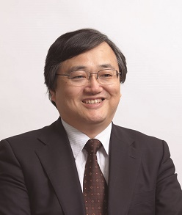
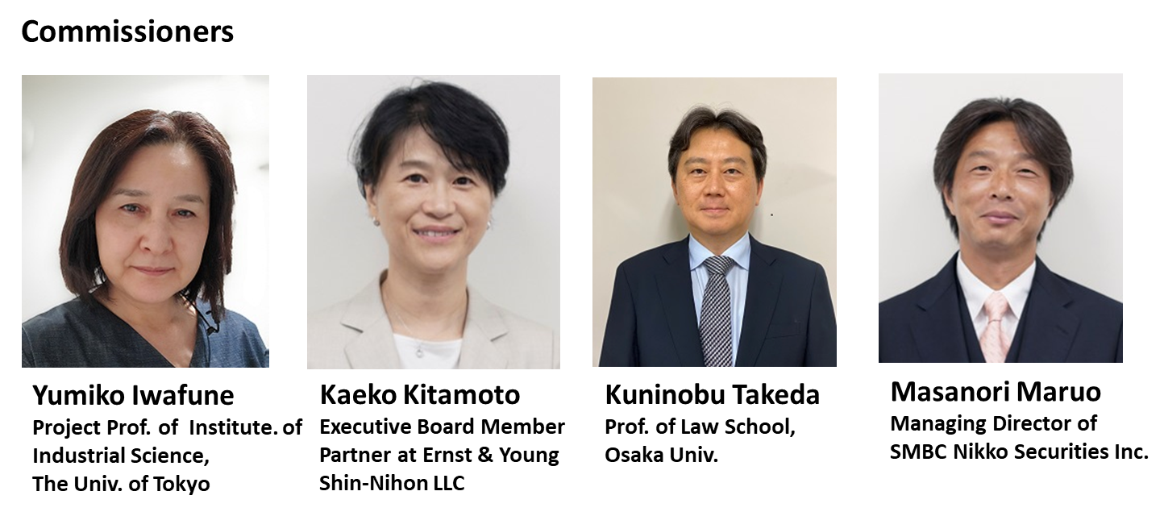

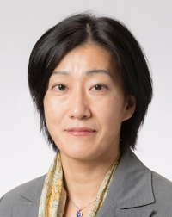
Independence starts with law
The electricity business act serves as EGC fundamental, and no one person decides.
Independent authority
Fixed-term commissioners
Collegial decision-making
Chairman
Commissioners
Akihiko Yokoyama
Prof. Emeritus,
The Univ. of Tokyo
Kuninobu Takeda
Prof. of Law School,
Osaka Univ.
Yumiko Iwafune
Prof. of Institute of industrial science,
The Univ. of Tokyo
Toshihiro Matsumura
Prof. of Institute of Social Science,
The Univ. of Tokyo
Kumiko Muramatsu
Accountant

Slide 4
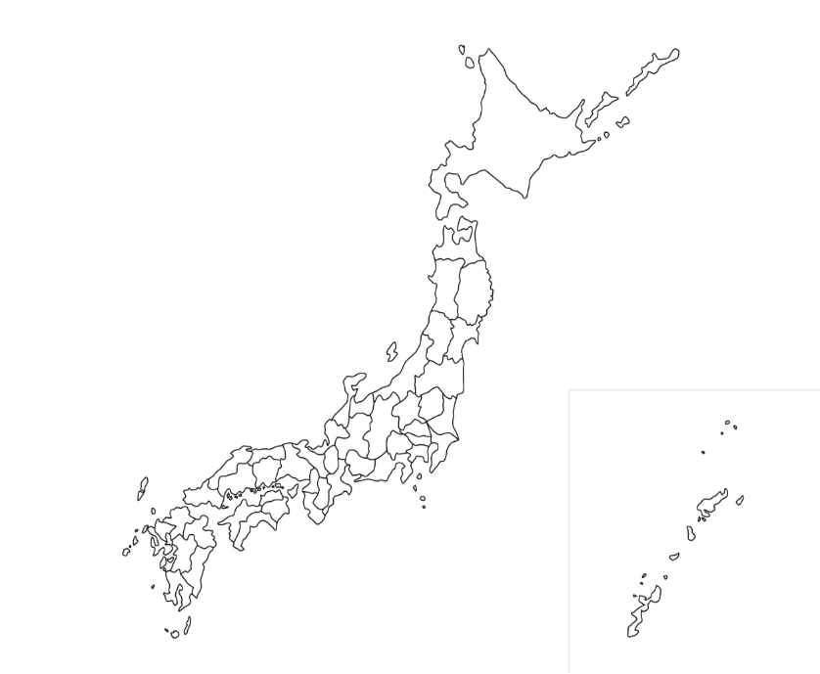
Expertise makes independence possible
The EGC operates a headquarters and nine regional offices, with a total of approximately 140 staff members.
The ratio of professional staff within the headquarters reaches 41%.

Slide 5

Budget without dependence
No direct financial relationship with regulated entities.
Direct levy model
Japan’s model
Many regulators
The National Diet of Japan
Agency for Natural Resource and Energy
etc..
Operators

Slide 6
Key Message from Japan
Regulatory independence requires
Legal safeguards
Collegial governance
Professional expertise
Institutional culture
Secure funding
Independence is not guaranteed by law alone. It must be practiced every day.

